Slide 1


Robotic Process Automation using UiPath
Topic 5- File, Folder Automation in StudioX: Microsoft Excel Automation
HITESH KUMAR SHARMA
Technical Instructor & Consultant

Slide 2

Introduction to RPA
StudioX Citizen Developer Journey and Working with StudioX
Activity Recording, UI Automation in StudioX
Decisions, Iterations, and Scenarios in StudioX
File, Folder Automation in StudioX: Microsoft Excel Automation
Email & SAP Automation in StudioX
Handle Errors in StudioX
COURSE OBJECTIVES

Slide 3
5. File, Folder Automation in StudioX: Microsoft Excel Automation
Introduction to file and folder automation
Microsoft Excel automation
Cell, Range, Pivot, Chart and Workbook Activities

Slide 4
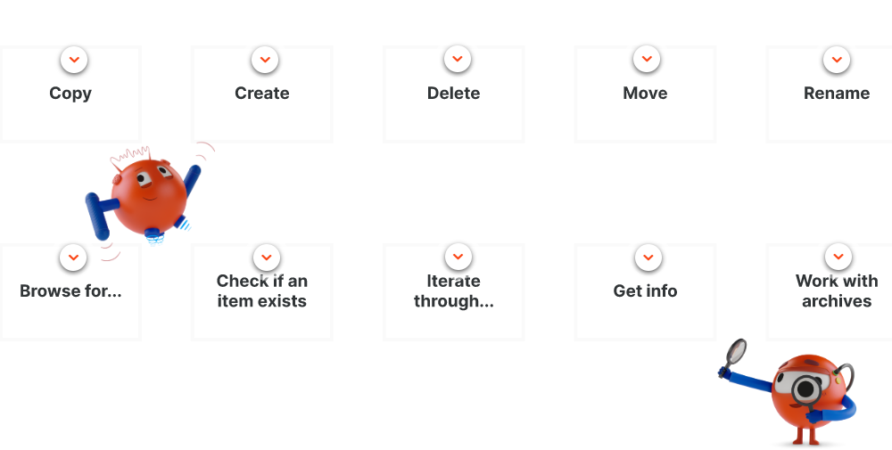
INTRODUCTION TO FILE AND FOLDER AUTOMATION
File and Folder Automation involves automating tasks you do with your files and folders on your computer, like creating, copying, or renaming them. StudioX offers a number of activities that help users automate tasks having to do with files and folders. Check out what you can most commonly do with them here:
You can find such actions as the ones listed above in the File/Folder section of the Activities panel. For this type of actions, you don't need a specific resource. You'll have to select those depending on the nature of the task you're automating, if it involves other kinds of activities, such as Excel, email, etc.

Slide 5
INTRODUCTION TO FILE AND FOLDER AUTOMATION
(Hands-on)
It might be easier to understand the topic in relation to a realistic business scenario, so let's take a practical example. Meet Jude, the Financial Clerk. They deal with loads of invoices daily and, sadly, a considerable part of them have the name wrong.
For efficient record keeping, Jude must ensure all documents are named correctly, but this tedious and repetitive work takes up much time and energy, as it requires attention. We'll now make Jude a gift: an automation workflow that makes it possible for them not to waste all those precious resources and frees them for other tasks.
In developing the automation you'll use the following input file:
Invoices Archive - You'll use this Zip file to automate the task described above.

Slide 6
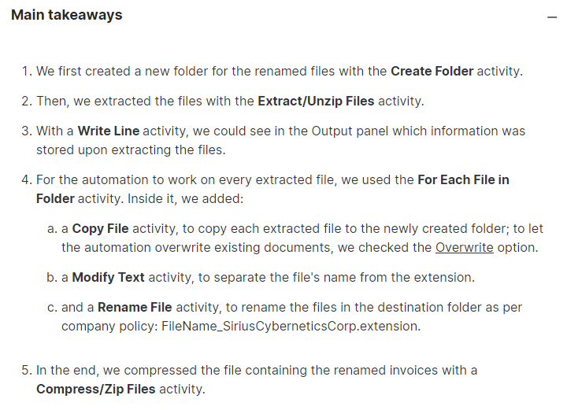
INTRODUCTION TO FILE AND FOLDER AUTOMATION
(Hands-on)

Slide 7
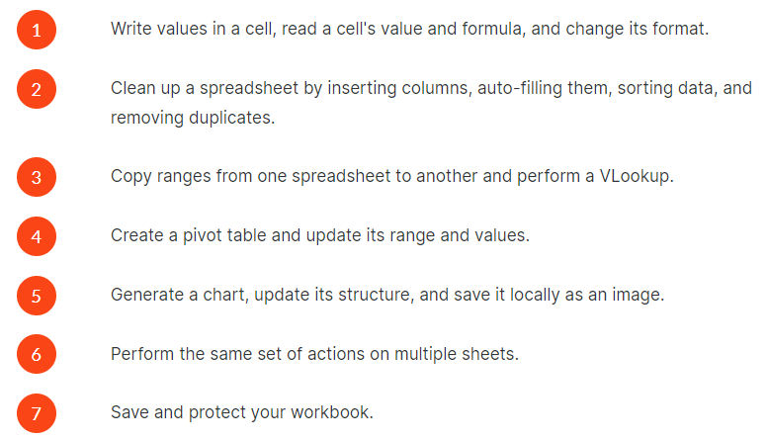
MICROSOFT EXCEL AUTOMATION
Firstly, let us ask you one question: which of your Microsoft Excel processes could and should be automated?
You likely work with Excel quite often as a business user. One repetitive task you may be performing is cleaning up data and generating pivot tables from downloaded csv reports. Maybe you reconcile two reports at the end of each week. These are tasks you can easily automate in StudioX.

Slide 8
MICROSOFT EXCEL AUTOMATION
Using UiPath StudioX, you can automate operations on Excel files through a variety of dedicated activities.
Listed under the Excel category are all the Excel activities, grouped into five categories: Cell, Chart, Pivot Table, Range, and Workbook. We'll show you how to use each set of activities in the next lessons.
There's one resource activity called Use Excel File.
If you are working with multiple Excel files at the same time, nesting the Excel resources inside an Excel Process Scope activity helps you decide what to do in case of alerts or conflicts occurring at runtime.
If your task requires repeating the same set of actions for each row, or for each sheet, you'll find two dedicated iteration activities: For Each Excel Row, and For Each Excel Sheet.

Slide 9
MICROSOFT EXCEL AUTOMATION- Cell Activities
(Hands-on)
In the following Demo, you'll help Taylor, the HR Specialist, combine data from two columns. You'll achieve this by configuring and using the Read Cell Value, Read Cell Formula, AutoFill and Write Cell activities.
In developing the automation you'll use the following input file:
manual_input.xlsx - You'll create the Full Name value by concatenating the First Name and Last Name values using StudioX activities.

Slide 10
MICROSOFT EXCEL AUTOMATION- Range Activities
(Hands-on)
In the following Demo, you'll help Taylor, the HR Specialist, combine data from three Excel files. You'll achieve this:
using the Insert Column, Sort Range and Remove Duplicates to organize the spreadsheets.
and configuring the VLOOKUP and Append Range activities to bring data from one file to another.
In developing the automation you'll use the following input files:
employee_data.xlsx - you'll use this file to retrieve the email address for each employee.
manual_input.xlsx - you'll write down the email address for each employee and adjust the structure of the sheet to match the annual_time_off.xlsx workbook.
annual_time_off.xlsx - you'll bring all the data from the manual_input.xlsx workbook and remove any duplicate entries.

Slide 11
MICROSOFT EXCEL AUTOMATION- Pivot Activities
(Hands-on)
In the following Demo, you'll continue helping Taylor, to create an overview of how the team took their days off. You'll achieve this:
using the Create Pivot Table activity to aggregate the data.
and configuring the Format Data activity to highlight employees who haven't rested enough.
In developing the automation you'll use the following input file:
annual_time_off.xlsx - you'll create a new sheet and then insert a Pivot table to aggregate the data from the main sheet.

Slide 12
MICROSOFT EXCEL AUTOMATION- Chart Activities
(Hands-on)
In the following video, you'll support Taylor with creating a visualization of the aggregated data. You'll achieve this:
configuring the Insert Chart activity to create a pie chart and the Update Chart activity to personalize the graphic.
and sending the chart by using email and the Get Chart activities.
In developing the automation you'll use the following input file:
annual_time_off.xlsx - you'll insert the chart right next to the pivot table.

Slide 13
MICROSOFT EXCEL AUTOMATION- Workbook Activities
(Hands-on)
In the following video, you'll learn how to protect Taylor's work from unauthorized changes. You'll achieve this:
by setting passwords for each sheet in the workbook using the Protect Sheet and For Each Excel Sheet activities.
In developing the automation you'll use the following input file:
annual_time_off.xlsx - you'll generate a unique password for each sheet in the workbook.

Slide 14
TOPIC 5
END
THANK YOU

